Slide 1

Physical Inputs for Simulations of Gravitational Wave Emissions from Compact Stars
within the Einstein Telescope Detection Range
Yaiza cano and caden phIllips

Slide 2
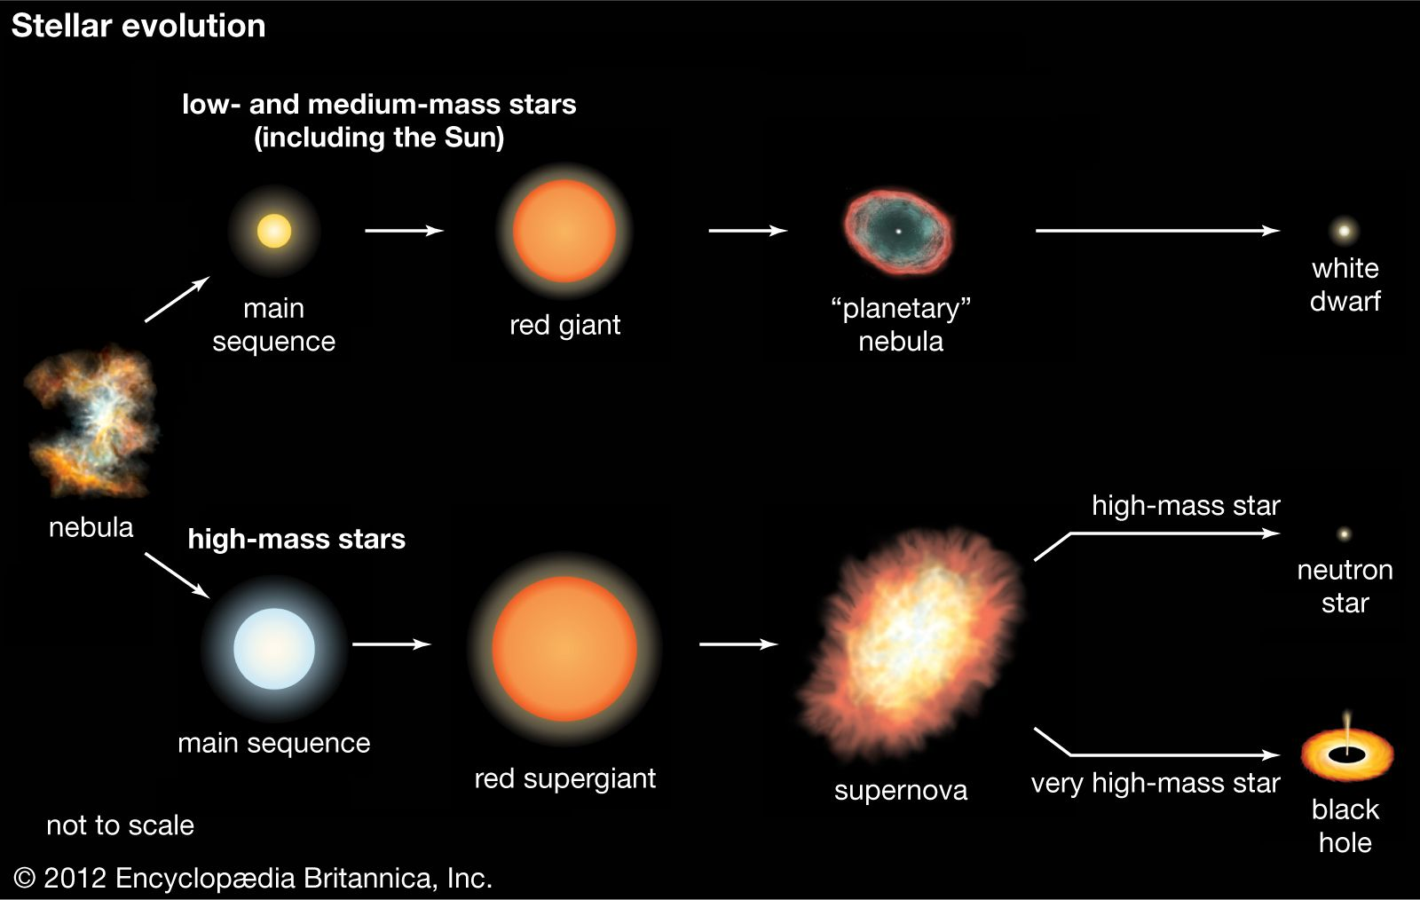
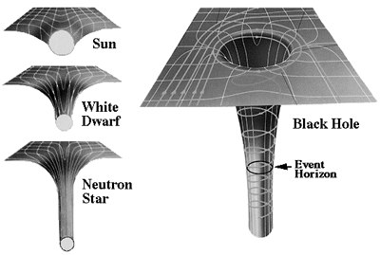
What are compact objects?

Slide 3
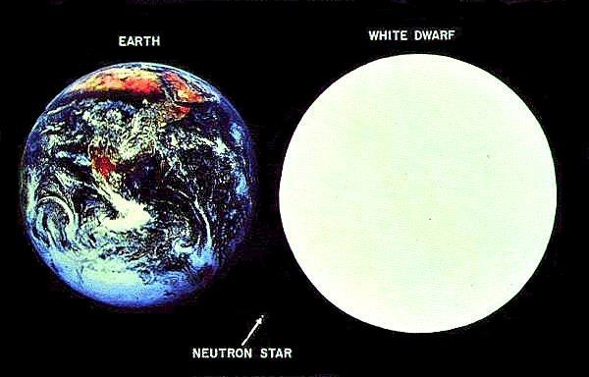
What are compact objects?
 | Mass (M⊙ ) | Radii (km)
White dwarf | 0.17-1.33 | 5000-14000
Neutron star | 0.7-2.5 | 11-15
Black hole | 5-10¹¹ | 30-10¹¹

Slide 4
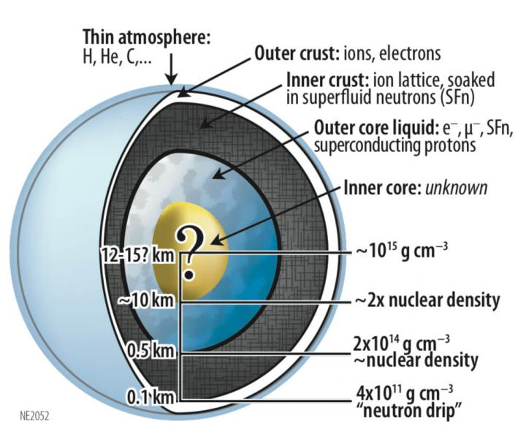
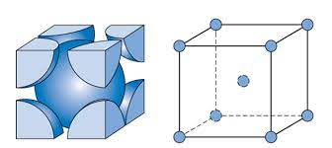
Neutron star structure
Outer crust:
~100m

Slide 5
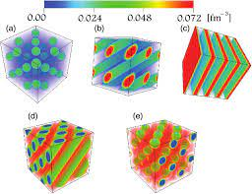
Neutron star structure
Inner crust:
~400m
2.6x10⁻⁴fm⁻³ (neutron drip point)

Slide 6
Neutron star structure
Outer core
~10km
0.08 fm⁻³
Uniform "liquid" matter

Slide 7

Neutron star structure
Inner core
2-5km
0.34 fm⁻³

Slide 8
Neutron star structure
Inner core
Up to 1.6 fm⁻³
Maybe Quark Matter?

Slide 9
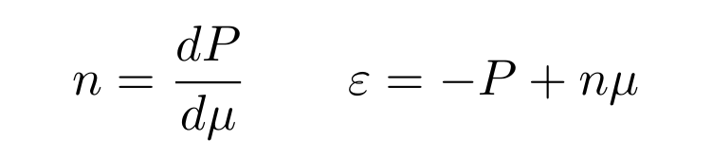
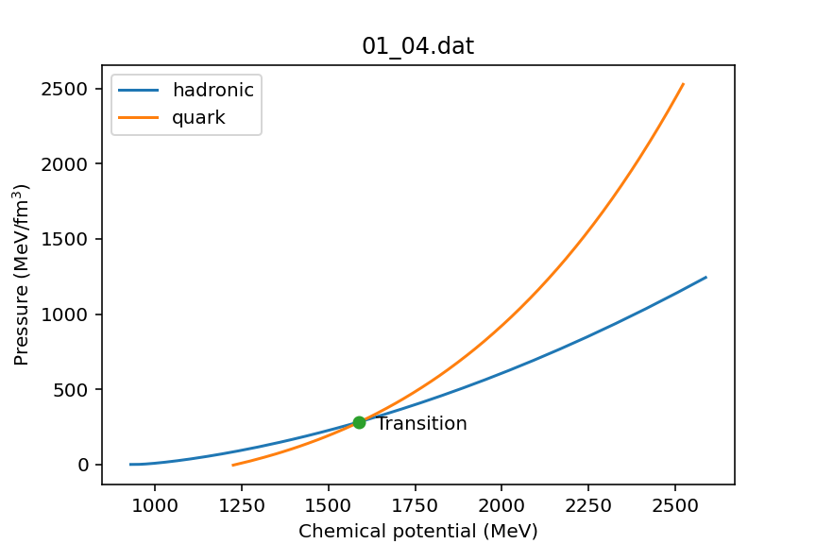
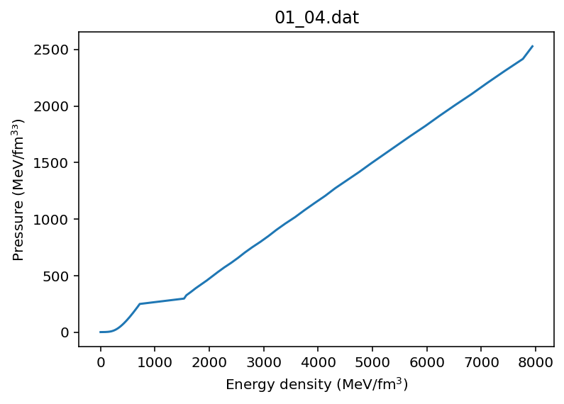
Maxwell construction of an Hybrid eos
Maxwell Construction for phase transitions
Find intersection point of both functions
Compute number density
Compute energy density

Slide 10
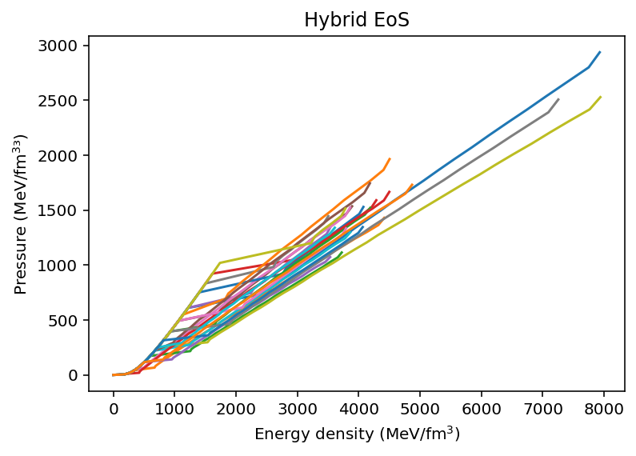
Maxwell construction of an Hybrid eos
Maxwell Construction for phase transitions
Quark model has multiple variables
How can we identify the "correct" EoS?
Mass-Radius curve (TOV equations)
Tidal deformability

Slide 11
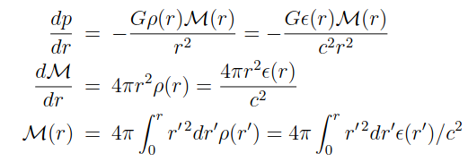
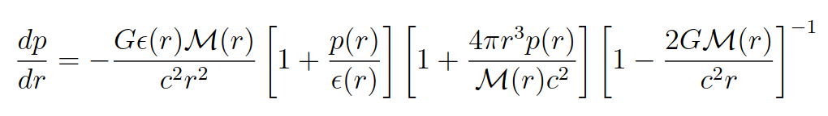
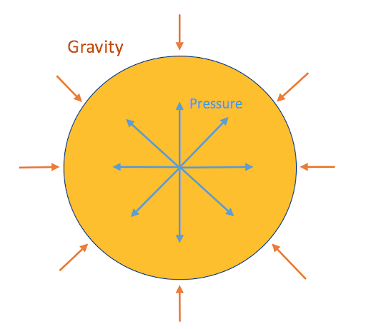
Structure equations: Hydrostatic equilibrium
Classical Newtonian Mechanics
Tolman–Oppenheimer–Volkoff equation

Slide 12
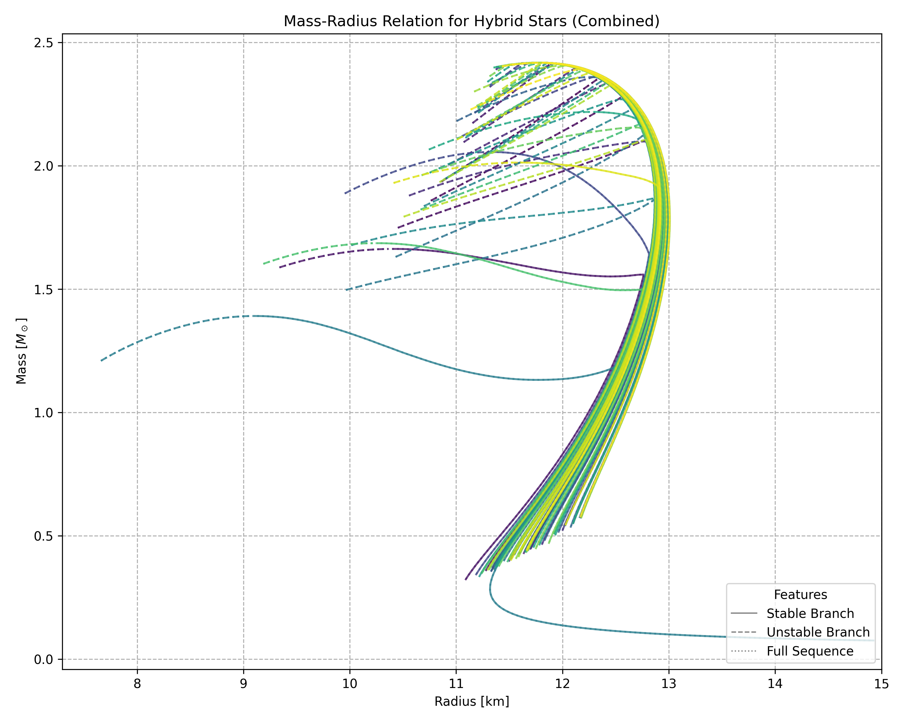
Mass-Radius Relations for Different Hybrid EoS
Mass-Radius relationship between 62 different generated EoS files, modelling 400 stars each.
Predicted maximum mass ranges from 2.0M☉ to 2.4M☉ in the stable branches.
Radius of stars in the stable branch range from 11km to 13km.
From the large variation in mass and radius, we can determine a lot about the constraints of the underlying Equations of State (EoS).

Slide 13
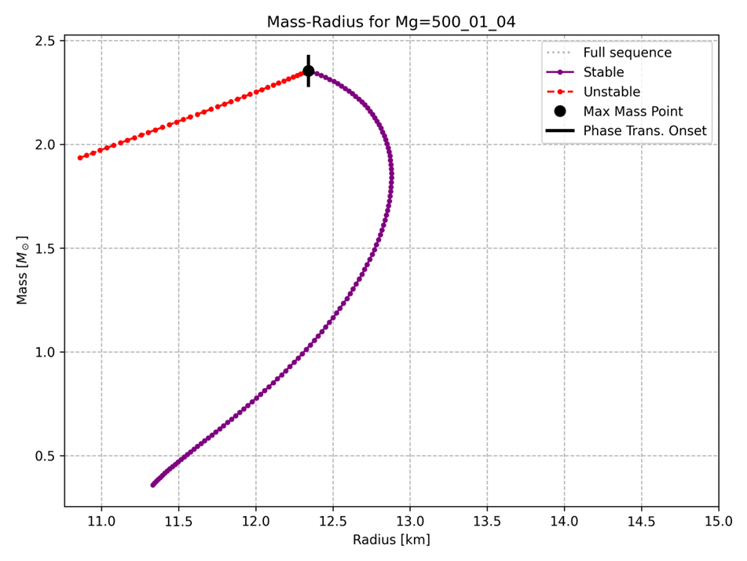
EoS file: Mg=500_01_04 – Representative example of majority
Rising Branch (Up to 1.5M☉) – Both mass and radius increase. The internal pressure generated by neutron degeneracy is strong enough to cause the star to expand when more mass is added.
Plateau (1.5M☉ to 2M☉) – The EoS reaches its maximum stellar radius. The internal pressure balances with the gravitational compression, forcing the star to become more compact.
Turnover (2M☉ to 2.3M☉) – The radius begins to decrease as general relativity takes over. The gravity becomes so intense that the star must become more compact in order to support the additional mass, peaking at 2.355M☉.
Unstable Branch – Stars that are perfectly balanced but incredibly unstable. If this balance is disturbed, even slightly, the star's internal pressure can no longer fight its own gravity, and it will immediately collapse into a black hole.

Slide 14
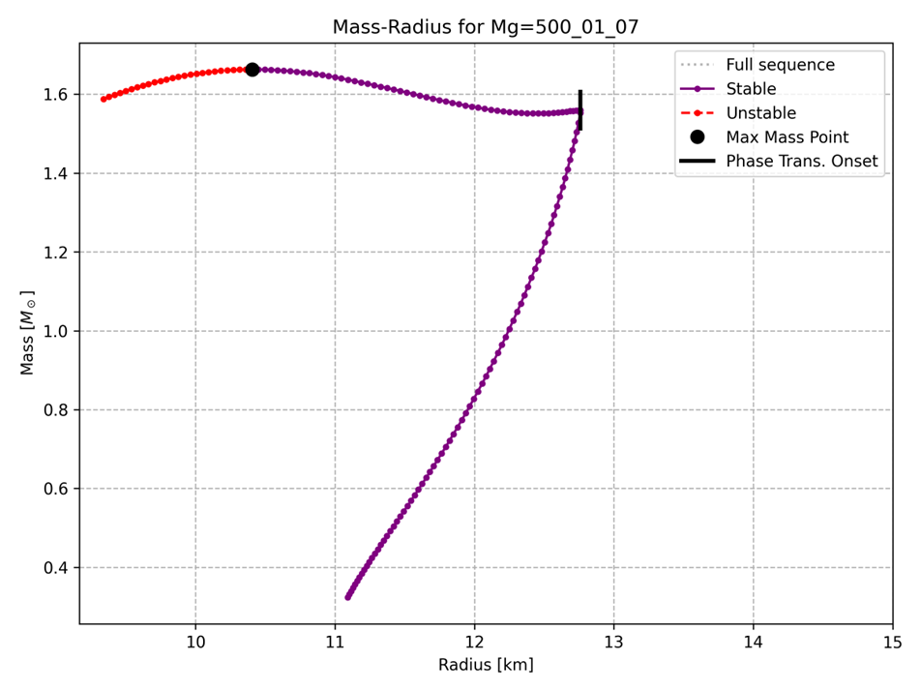
EoS file: Mg=500_01_07
Phase Transition Onset – At 12.76km and 1.56M☉ undergoes phase transition. Purely Hadronic core becomes quark core.
Goldilocks Zone – Hybrid branch where matter is too soft for star to expand with added mass and too stiff to immediately collapse. Instead shrinks to produce internal pressure to counteract gravity.

Slide 15
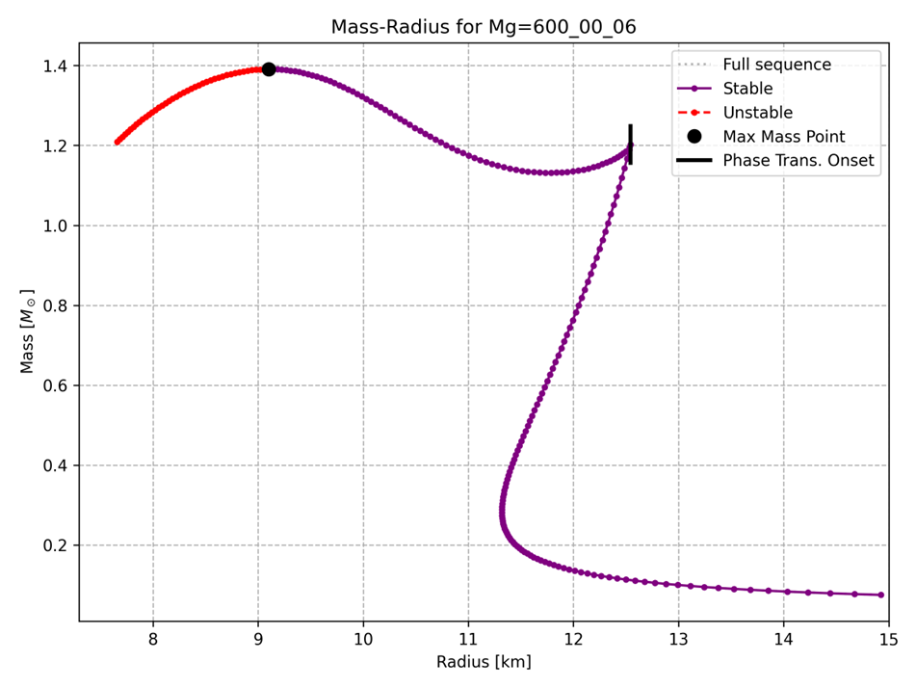
EoS file: MG=600_00_06
Low Mass Tail – Occurs when gravitational strength is weak enough at very low central densities, allowing low mass star to expand without becoming unstable.
Twin Stars – If the EoS goes through a strong enough first-order phase transition, it can create a second, separate branch of stable hybrid stars. This allows two different, stable stars to exist at the same mass: one is a purely hadronic star, and the 'twin' is a hybrid star with a different radius

Slide 16

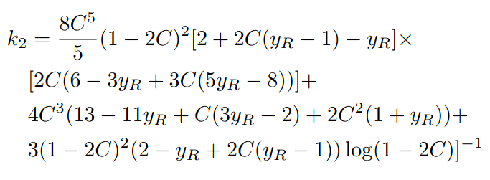
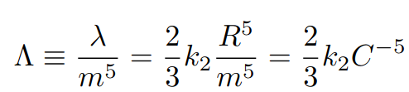
Tidal Deformability equations
At the core of the star, y(r) = 2. Knowing this, we can then integrate in minute steps of radius until we reach the surface of the star, at radius R, where its pressure has reached 0. y(r) at this point is y_{R}.
Once we know the value of y_{R} for a specific star, we can then implement this into the love number equation and calculate the love number, k₂.
Now we know the value of k₂, the mass and radius of a certain star, we can calculate its tidal deformability.

Slide 17
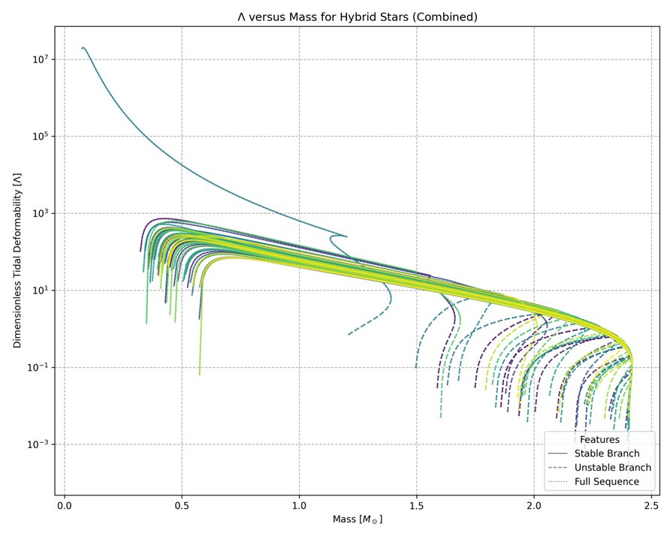
Tidal Deformation-Mass Relations for Different Hybrid EoS
Tidal Deformability-Mass relationship between the same 62 generated EoS files modelling 400 stars for each file.
For a typical 1.4M☉ star, the predicted dimensionless tidal deformability, Λ, shows a wide range, from approximately 100 to 800.
Λ ∝ C⁻⁵
With a large variation in tidal deformability, it can be determined that gravitational wave observations of merging neutron stars can provide strong constraints on the underlying EoS.

Slide 18
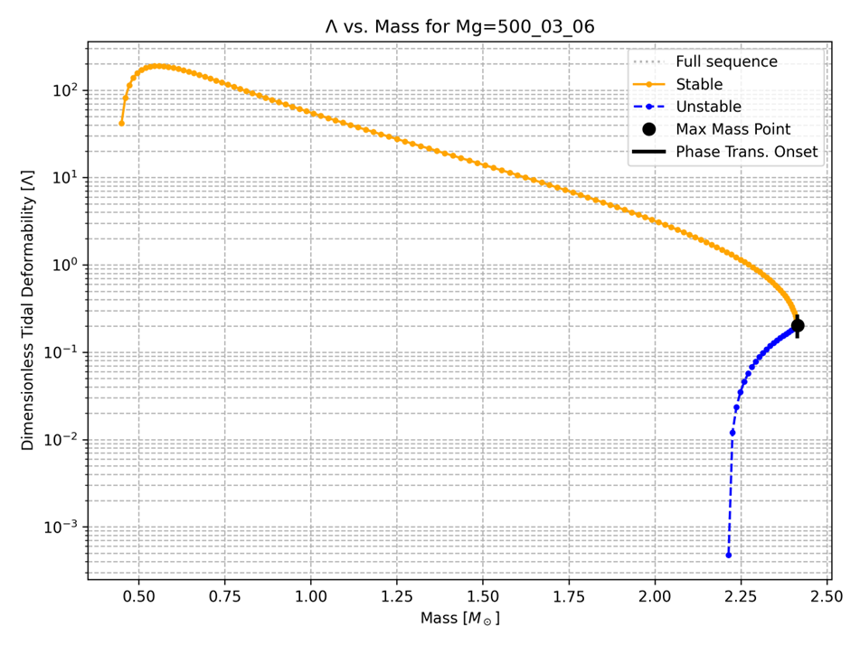
EoS file: Mg=500_03_06 - Representative example of majority
Initial Rise (Up to 0.5M☉) – Purely Hadronic, tidal deformability is high as these stars are very soft. The tidal deformability rises as the mass and radius increase.
Plateau (0.5M☉ to 0.6M☉) – Compactness increases causing the tidal deformability to no longer increases with mass.
Decline (0.6M☉ to 2.25M☉) – Compactness continues to increase as the tidal deformability decreases with mass.
Rapid Decline (Over 2.25M☉) – As stars continue to become more compact due to the star’s radius decreasing, the tidal deformability drops rapidly due to the relation Λ∝C⁻⁵ until they become unstable and collapse.

Slide 19
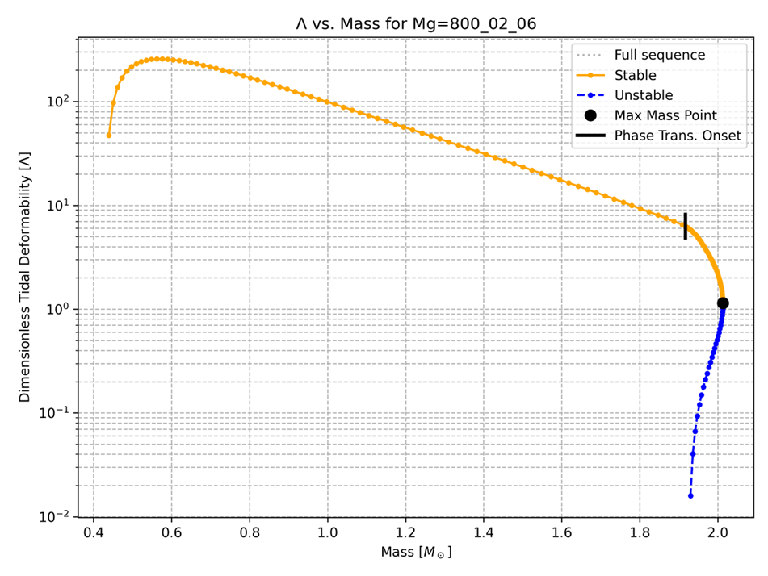
EoS file: Mg=800_02_06
The phase transition to a softer quark-matter EoS allows the core to become significantly denser. This causes the compactness to increase dramatically, causing a massive drop in tidal deformability.

Slide 20
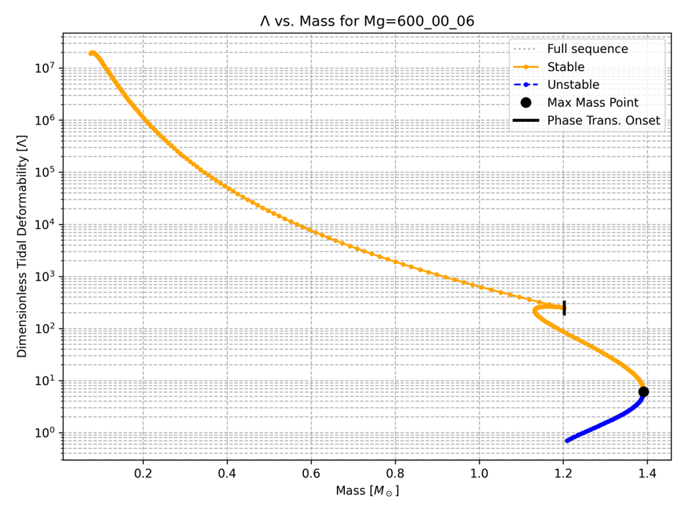
EoS file: Mg=600_00_06
If the first-order phase transition is strong enough, it can cause the internal structure of the star to change dramatically.
A rapid decrease in mass is caused by a significant release of gravitational binding energy.
This structural change dramatically affects tidal deformability, creating a characteristic "hook" in the plot. As the core densifies, the star stabilises, and mass increases again.

Slide 21
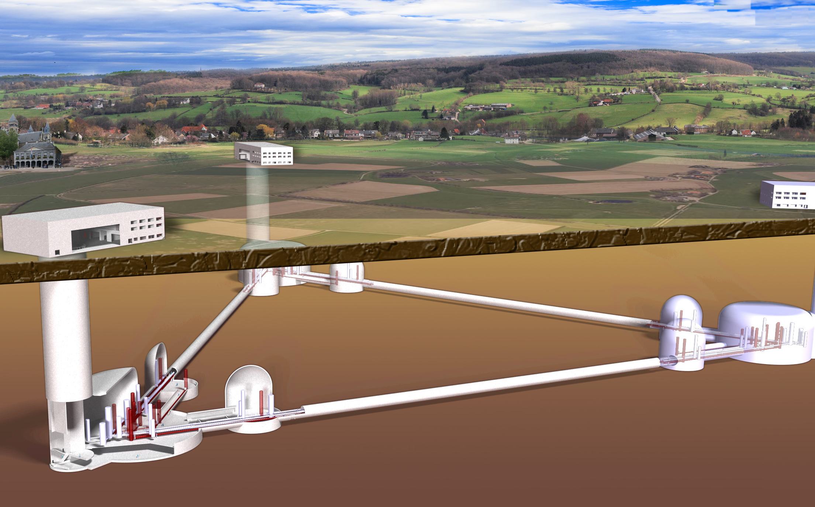
Gravitational Waves
Tidal Deformability – This affects how neutron stars merge. If Λ is larger, they will merge faster. Causing a higher frequency gravitational wave.
How does tidal deformability affect statistical errors?
- We can use tools such as fisher analysis to determine how precisely we can measure parameters.
Proposed Einstein Telescope

Slide 22
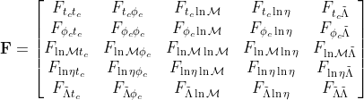
conclusion
Limitations – Used compactness limit of 0 < C < 4/9. This is known as the Buchdahl Limit. It assumes perfect fluidity.
Assumes stars are zero temperature and non-spinning.
What we would've liked to do – Used our Fisher Matrix model and add tidal deformability as a 5th parameter.

